Slide 1

CREDIT CARD CHURN Prediction
By
Lavina Kunder

Slide 2

BACKGROUND
The Thera bank recently saw a steep decline in the number of users of their credit card, credit cards are a good source of income for banks because of different kinds of fees charged by the banks like annual fees, balance transfer fees, and cash advance fees, late payment fees, foreign transaction fees, and others. Some fees are charged to every user irrespective of usage, while others are charged under specified circumstances.
Customers’ leaving credit cards services would lead bank to loss, so the bank wants to analyze the data of customers and identify the customers who will leave their credit card services and reason for same – so that bank could improve upon those areas
You as a Data scientist at Thera bank need to come up with a classification model that will help the bank improve their services so that customers do not renounce their credit cards

Slide 3
PROBLEM DEFINITION
Explore and visualize the dataset.
Data Preprocessing.
Logistic Regression Model Building.
Improving Model Perfomance and Regularization.
Bagging (bagging classifier, random forest, and decision tree.) and Boosting (Adaboost, gradient boost, xgboost, and stacking classifier) Model building.
Tune the 3 best models from above using Grid Search and Random Search (using Pipelining)
Build a classification model to predict if the customer is going to churn or not
Optimize the model using appropriate techniques
Model Performance Evaluation
Generate a set of insights and recommendations.

Slide 4
DATA INFORMATION
There are 10 attributes of type INTEGER.
There is 5 attributes of type FLOAT.
There are 6 attributes of type OBJECT.
TOTAL : 21 Attributes.
There are 10127 rows and 21 columns

Slide 5
DATA PREPROCESSING I
This part of Data Pre-processing is done to understand the DataSet better and for UNIVARIATE and BIVARIATE Exploratory Data Analysis.
Further Data Pre-processing will be done after EDA is complete.
Pre Processing Done :
1) DROP UNNECESSARY COLUMNS (CLIENTNUM)
2) PROCESSING COLUMNS (Attrition_Flag type and content correction)

Slide 6
UNIVARIATE ANALYSIS

Slide 7
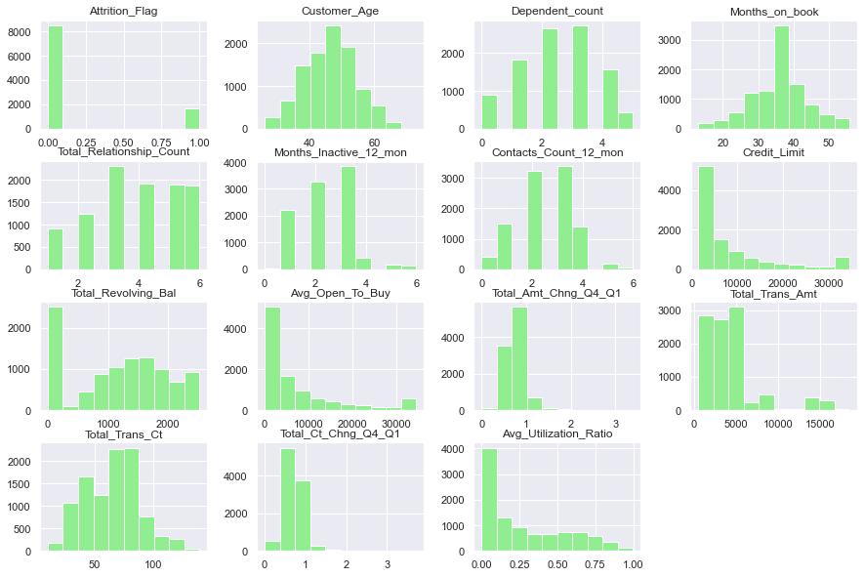
Histogram Plots
Histogram Plots of the various numerical Attributes present in the given Dataset. It shows the frequency of each element within the attribute.

Slide 8
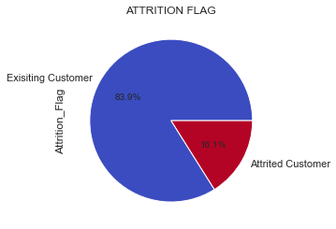
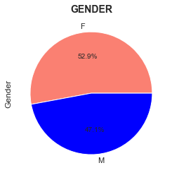
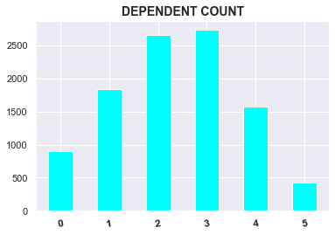
Variable Analysis
Almost 84% of the dataset is existing customers.
Only 16% are Attrited Customer (i.e.: Customers have left.)
The Attriton Flag Distribution is highly imbalanced (Skewed)
Gender seem to be a balanced column, with 53% Female and 47% Male Customers.
Over 5000 customers have 2 - 3 dependents making up a large chunk of the dataset.
Very few customers (less than 500) have 5 dependents.

Slide 9
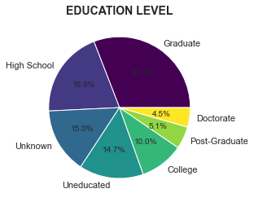
Variable Analysis
Almost 50% of the dataset constitutes of Graduates and High School Diploma Customers of which Graduates account for the largest chunk.
Less than 10% of the dataset makes up of customers with Doctorates and Post-Graduated Degrees.
15% of the customers have not provided any information on their education level.

Slide 10
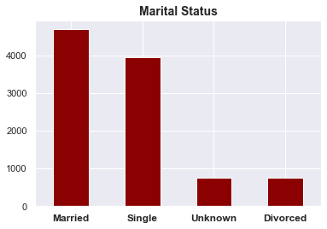
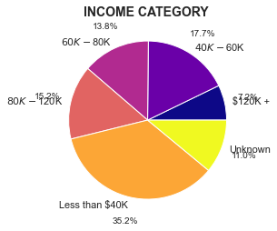
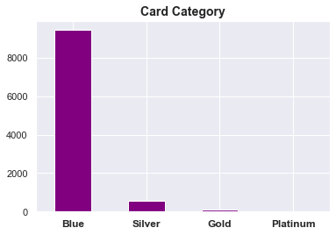
Variable Analysis
Most of the users are either Married (4500+) or Single (~4000).
Very few customers are divorced.
Few Customers have not provided info on their Marital Status.
Almost 50% of the DataSet earns less than 60K Dollars.
Very small percentage of the dataset earns more than 120K Dollars.
Few Customers have not provided info on their Income.
Most of the users belong to the Blue Category. ***
Negligible number of customers have the Platinum Category of Credit Cards.
Very few customers have Silver or Gold Category of Credit Cards.

Slide 11
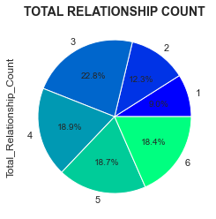
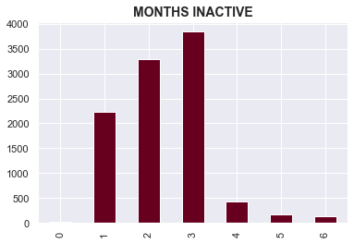
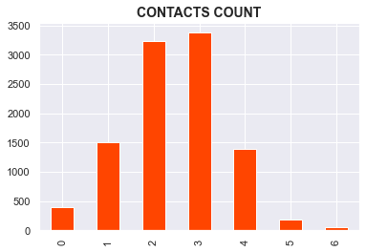
Variable Analysis
3 is the highest relationship count for the customers in the dataset.
Mostly seems to be evenly distributed.
Months Inactive ranges from 0 - 6 months.
Most customers have 3 month of inactivity followed by 2 and then 1.
Contacts Count ranges from 0 - 6.
Most customers have 3 contacts followed by 2 and then 1.

Slide 12
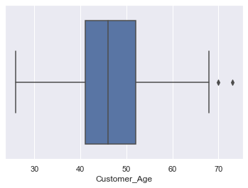
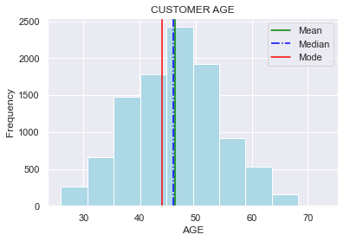
CUSTOMER AGE DISTRIBUTION
Customer Age seems to be largely evenly distributed.
The Customer Age mean is seems to be around 46 - 47. Minimum Customer Age is 26 and Maximum Age is 70. There seems to be no discrepancy.

Slide 13
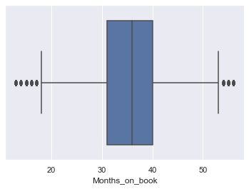
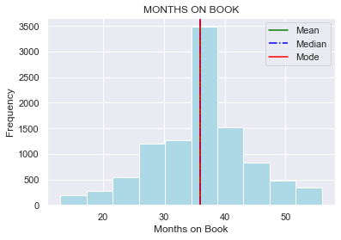
MONTHS ON BOOK DISTRIBUTION
Mean = Median = Mode
Most of the customers have almost 35 - 40 months on book.
Ranges from 10 - 60 months

Slide 14
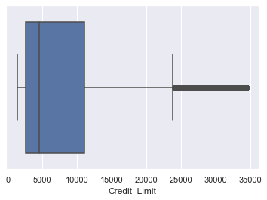
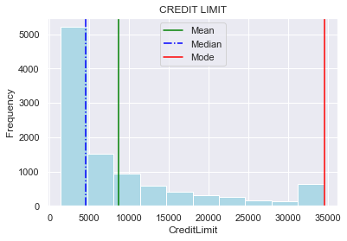
CREDIT LIMIT DISTRIBUTION
Median < Mean < Mode
Most of the customers are in the 0 - 5000 Credit Limit.
Ranges from 0 - 35000.

Slide 15
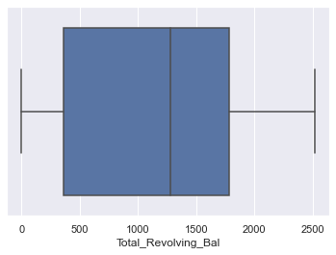
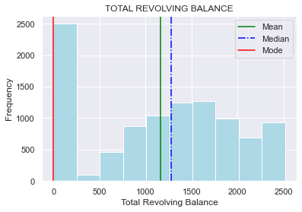
TOTAL REVOLVING BALANCE DISTRIBUTION
Mode < Mean < Median
Most of the customers have a revolving balance of 0 - 250
Ranges from 0 - 2500.

Slide 16
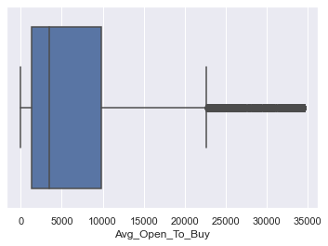
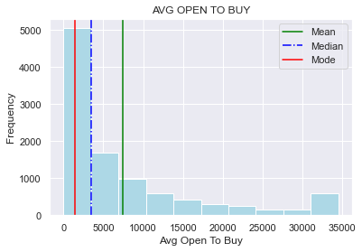
AVG OPEN TO BUY DISTRIBUTION
Mode < Median < Mean
Most of the customers are in the range 0 - 2500
Number of customers decreases as the average open to buy amount increases.

Slide 17
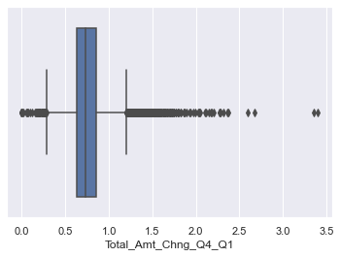
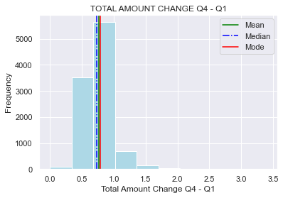
TOTAL AMOUNT CHANGE Q4 - Q1
Large Number of Outliers
The value is the ratio of Transaction Amt in Q4 to Q1. Since the Mean is less than 1, we can say that people transactless in Q4 than in Q1

Slide 18
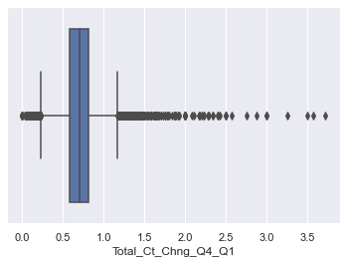
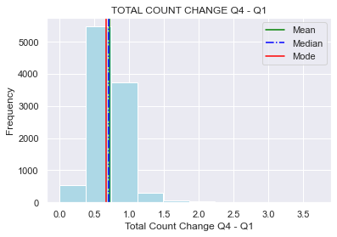
TOTAL COUNT CHANGE Q4 - Q1
Large Number of Outliers
The value is the ratio of Transaction Counts in Q4 to Q1. Since the Mean is less than 1, we can say that people transact less in Q4 than in Q1

Slide 19
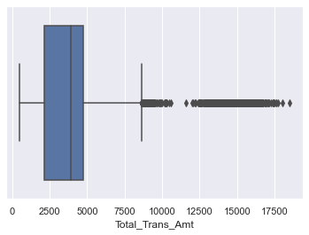
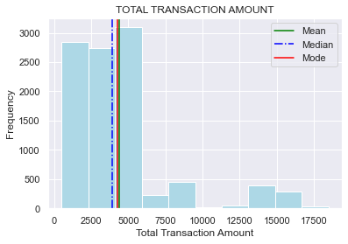
TOTAL TRANSACTION AMOUNT
Large Number of Outliers
Most Customers have transaction amounts ranging from 0 - 5000.
Customers having Transaction Amount in the range of 5000 - 17500 account for the large number of outliers.

Slide 20
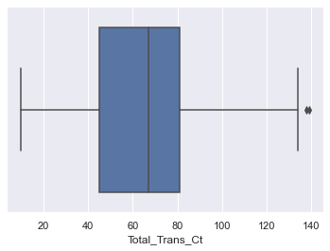
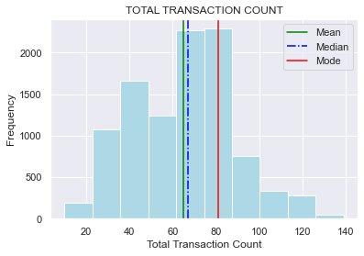
TOTAL TRANSACTION COUNT
Fairly distributed with less number of outliers.
On an average there are 60 - 65 transactions a year for a customer.

Slide 21
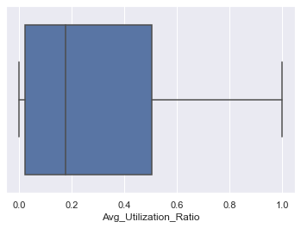
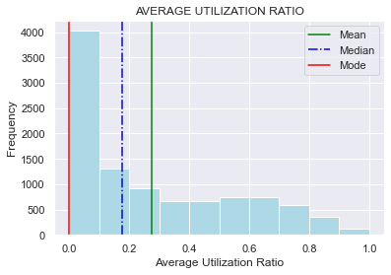
AVERAGE UTILIZATION RATIO
No Outliers.
A very large chunk of the population has an avg utilization ratio in the range of 0 - 0.1; showing that a large chunk of the population does not spend the available credit.

Slide 22
BIVARIATE & MULTIVARIATE ANALYSIS

Slide 23
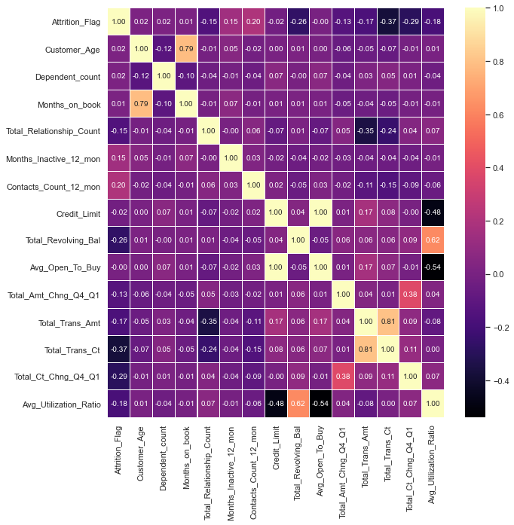
Correlation Heat Map
This Heat Map shows the correlation between the individual attributes. There is distributed correlation between the attributes of this dataset. With this we can draw the following inferences :
HIGH CORRELATION : Months_on_book and Customer_Age, Avg_Open_To_Buy and Credit_Limit.
MEDIUM CORRELATION : Avg_Utilization_Ratio and Total_Revolving_Bal
LOW CORRELATION : All Other Attributes

Slide 24
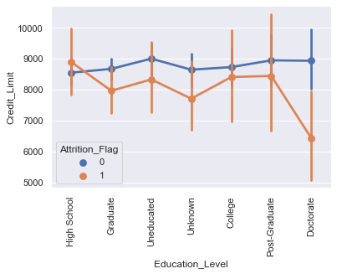
EDUCATION LEVEL v/s CREDIT LIMIT v/s ATTRITION FLAG
OBSERVATIONS
In the general sense, the credit limit is higher for existing cutsomers than for attrited customers except in the case of customers with high school degrees only where the opposite happens.
The credit limit does not have a huge difference between the existing cutsomers and attrited customers for varying levels of education, except for customers with a doctorate; where the difference is high.

Slide 25
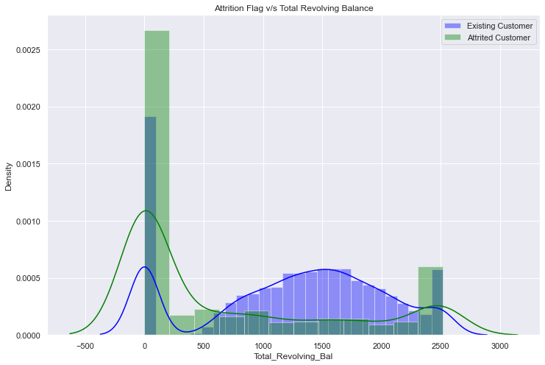
TOTAL REVOLVING BALANCE v/s ATTRITION FLAG
OBSERVATIONS
Total Revolving Balance in the 0 - 500 range has a higher number of Attrited Customers than Existing Customers.
This changes as the Total Revoloving Balance increases with the number of Existing Customers taking over the Attrited ones. Therefore Existing Customers have a mugh higher Total Revolving Balance than attrited ones.
As the Total Revolving Balance further increases to 2500, the number of Existing customers and Attrited customers in this range equalizes.

Slide 26
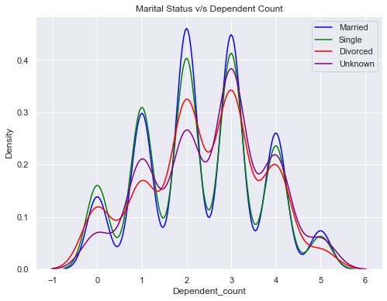
MARITAL STATUS v/s DEPENDENT COUNT
OBSERVATIONS
Customers of different Marital Statuses arranged in Descending order with respect to their Dependent counts :
0 Dependents : Single > Married > Divorced > Unknown
1 Dependents : Single > Married > Unknown > Divorced
2 Dependents : Married > Single > Divorced > Unknown
3 Dependents : Married > Single > Unknown > Divorced
4 Dependents : Married > Single > Unknown > Divorced
5 Dependents : Married > Single = Unknown > Divorced
GENERAL : Married Customers ahve the most dependents and Divorced Customers have the least.

Slide 27
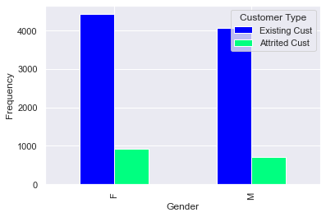
GENDER v/s ATTRITION FLAG
OBSERVATIONS
The existing and attrited customer values for both genders is more or less the same with Females leading both categories only by a very small margin.

Slide 28
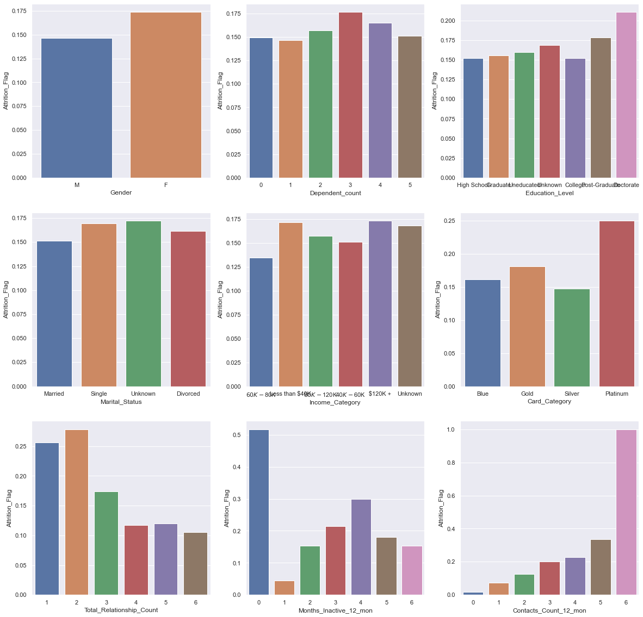
ATTRITION FLAG v/s OTHER VARIABLES
OBSERVATIONS
The graphs above average the numbers for the customers that have attrited (Left the Credit Card Services) across all atrributes and their subdivisions.
Inferences on ATTRITED CUSTOMERS

Slide 29
ATTRITION FLAG v/s OTHER VARIABLES
OBSERVATIONS
More Female than Male Customers.
Highest dependent count is 3 for for attrited customers.
Customers with doctorates are the most attrited customers.
Most attrited customers are either single or prefer not to give information on their marital status.
Most Attrited customers belong to the high income category with salary over 120K dollars. Although there are customers that do earn below 40k dollars that also leave the services.
Most attrited customers are the ones that had Platinum cards.
Most attrited customers had a low number of products / services with the bank (Total realtionship Count).
Attrited customers were constantly active. They have the lowest inactivity.
Attrited customers have the highest contact count.

Slide 30
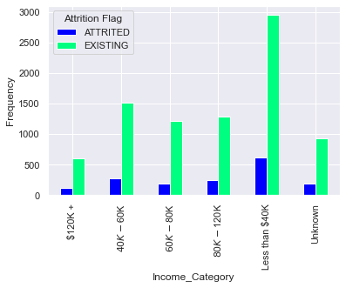
ATTRITION FLAG v/s INCOME CATEGORY
OBSERVATIONS
Attrited customers are far less compared to the existing ones across all Income Categories. But an increase in the individual numbers can prove to a point of contention for the bank.

Slide 31
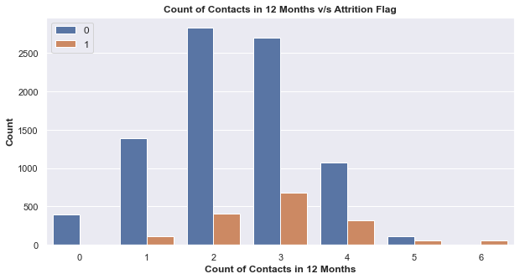
ATTRITION FLAG v/s CONTACT COUNT
OBSERVATIONS
Count of contacts increases in attrited customers.
Only existing customers have 0 count of contacts.

Slide 32
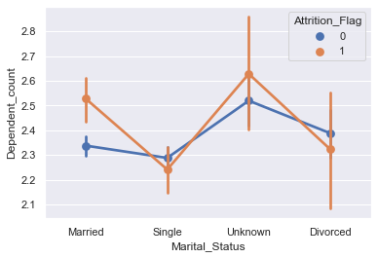
ATTRITION FLAG v/s MARITAL STATUS v/s DEPENDENT COUNT
OBSERVATIONS
Existing customers have a higher dependent count in the case of Single and Divorced customers.
Attrited customers have a higher dependent count in the case of Married and Unknown Customers.

Slide 33
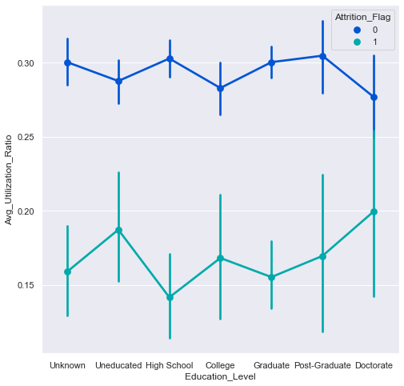
ATTRITION FLAG v/s EDUCATION LEVEL v/s AVG UTILIZATION RATIO
OBSERVATIONS
Existing customers have a much higher utilization ratio as compared to attrited customers across all education levels.

Slide 34
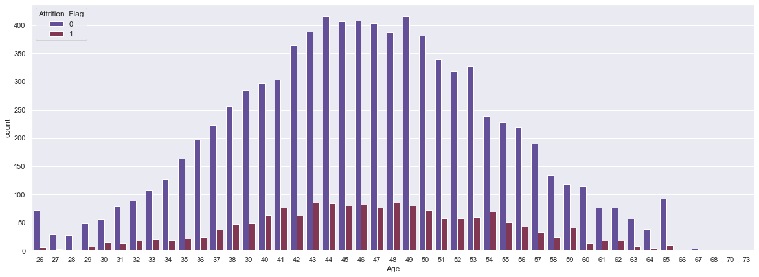
ATTRITION FLAG v/s CUSTOMER AGE
OBSERVATIONS
Chances of attrition increase as the age of the customer increases upto a certain point (47 years) after which it declines as the age increases (upto 73 years)

Slide 35
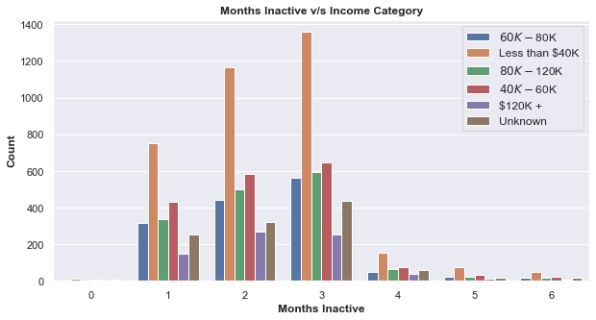
MONTHS INACTIVE v/s INCOME CATEGORY
OBSERVATIONS
For all the income categories the inactive months increase form 1 to 3 months, after which there is a sharp decline in inactivity.

Slide 36
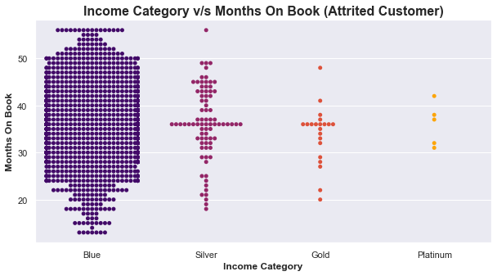
CARD CATEGORY v/s MONTHS ON BOOK (ATTRITED CUSTOMER = YES)
OBSERVATIONS
Blue and Silver Card category attrited customers show the highest value for months on book.
Blue category has the highest number of attrited customers.

Slide 37
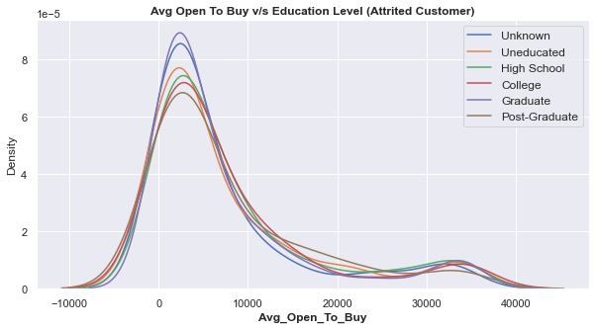
EDUCATION LEVEL v/s AVG OPEN TO BUY (ATTRITED CUSTOMER = YES)
OBSERVATIONS
In the 0 to 1000 range of Average Open To Buy, as education level increases, the avg. open to buy decreases. Except in the case of Graduate degree holders which prove to be an anomaly and have a much higher density of avg. open to buy, thus deviating from the standard trend.

Slide 38
Key Insights based on EDA
Months on Book only ranges from 10 - 60 months. This data would not be enoguh in predication of customers with accounts less than a year or greater than 5 years.
Imbalanced credit limit many discourage customers from continuing with the banks services.
Low revolving balance shows that customers may churn whihch is why they have low balances saved with the bank.
Ratio of Transaction Amt and transcation count in Q4 to Q1 has a Mean less than 1. Therefore, we can say that people transact less in Q4 than in Q1
Very small transaction amounts accounts for people not very big on spending therefore not utilizing their credit card much.
The higher the number of transactions a customer has the less likely they are to leave.
Equal distribution among male and female credit card holders showing no discrepancy in the methods of providing credit cards to different genders by the bank.
Few customers have not provided any information on their Marital Status, Education Level or Income Category. This points to the fact that they may leave or attrite and thats why they did not provide any info

Slide 39
Key Insights based on EDA
Most customers hold a card from the blue category. This shows that the bank dislikes risk and does not provide a better category of card unless the customer has a higher income. Higher card categories are based on your salary income. This also points to the fact that most people on the dataset have less income. There could also be charges on the higher cards which is why people don't prefer it. This may vary from bank to bank.
Increase in inactivity or number of contacts may lead to attribution / churning. Point to problems in the bank or customer dissatisfaction.
Difference in credit limit between customers may contribute to churning.
Churning increases as Total revolving balance decreases.
Customers with doctorates and higher income are the most attrited customers. Specific targeted marketing to them may help.
Attrited customers were constantly active with high contact counts. Showing that they had some previaling issues with the bank because of which they had to constantly contact the bank and stay active in the working of their accounts.

Slide 40
Key Insights based on EDA
Married customers with higher dependent counts are likey to churn.
Blue and Silver Card category attrited customers show the highest value for months on book.

Slide 41
DATA PREPROCESSING II
FEATURE ENGINEERING
This part of Data Preprocessing is done to cater to the Model Building part of the project. It will help in easier development of the Logistic Regression Model and Decision Tree
CONTINUATION : Pre-Processing Done:
3) FIXING MISSING VALUES : No values to be fixed
4) FIXING DATA TYPE : Object converted to Category
5) OUTLIERS AND THEIR TREATMENT : Identifying the outliers in all columns and treating them

Slide 42
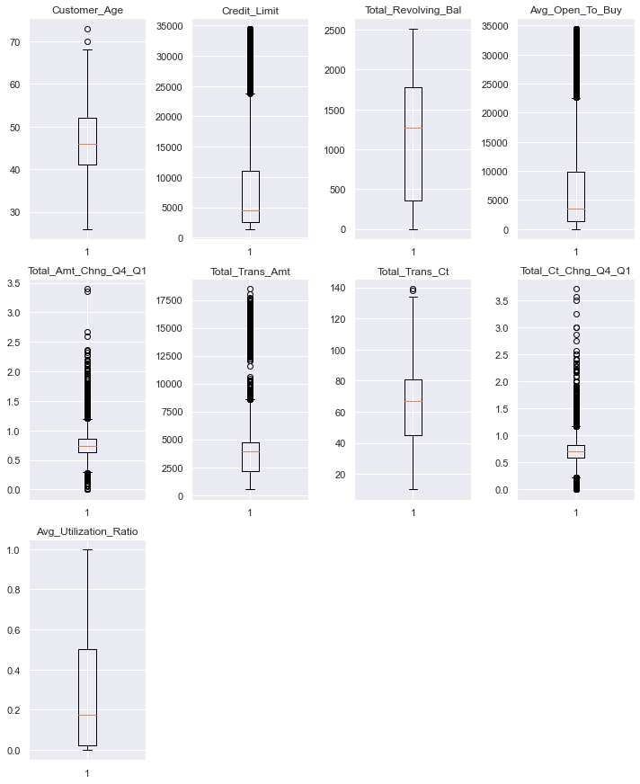
DATA PREPROCESSING II
The outliers will be left untreated as firstly, there aren't many outliers. Secondly, these outliers may prove to be important during the building of the boosting and bagging models.

Slide 43
MODEL BUILDING Bagging

Slide 44
3 Bagging Models were built. Their Confusion Matrices and Performance Metrics are as follows :

Slide 45
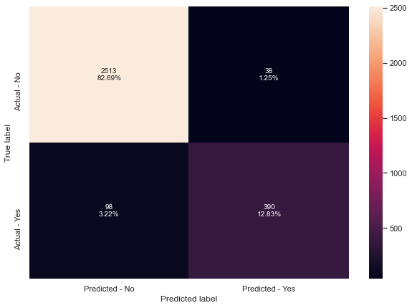
1) BAGGING CLASSIFIER
PERFORMANCE METRICS
Accuracy on training set : 0.9964729119638827
Accuracy on test set : 0.9552484369858506
Recall on training set : 0.9815627743634767
Recall on test set : 0.7991803278688525
Precision on training set : 0.9964349376114082
Precision on test set : 0.9112149532710281
F1-Score on training set : 0.9889429455992923
F1-Score on test set : 0.851528384279476

Slide 46
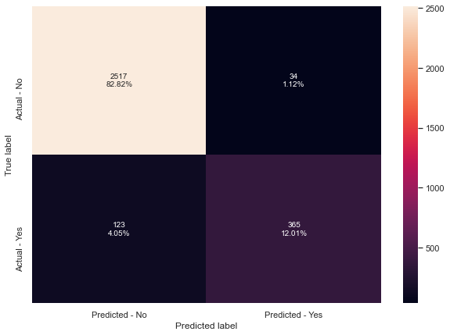
2) Random Forest
PERFORMANCE METRICS
Accuracy on training set : 1.0
Accuracy on test set : 0.9483382691674893
Recall on training set : 1.0
Recall on test set : 0.7479508196721312
Precision on training set : 1.0
Precision on test set : 0.9147869674185464
F1-Score on training set : 1.0
F1-Score on test set : 0.8229988726042842

Slide 47
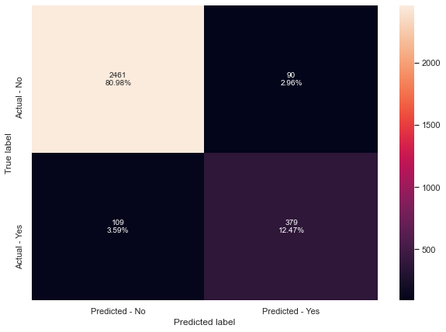
3) Decision Tree
PERFORMANCE METRICS
Accuracy on training set : 1.0
Accuracy on test set : 0.9345179335307667
Recall on training set : 1.0
Recall on test set : 0.7766393442622951
Precision on training set : 1.0
Precision on test set : 0.8081023454157783
F1-Score on training set : 1.0
F1-Score on test set : 0.7920585161964473

Slide 48
MODEL BUILDING Boosting

Slide 49
3 Boosting Models were built. Their Confusion Matrices and Performance Metrics are as follows :

Slide 50
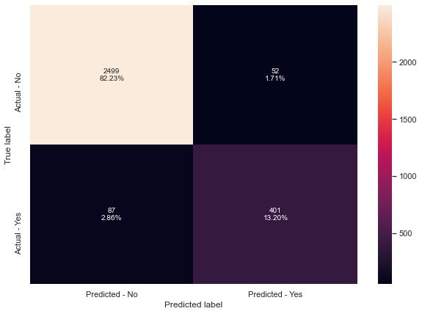
1) Adaboost Model
PERFORMANCE METRICS
Accuracy on training set : 0.9654345372460497
Accuracy on test set : 0.9542612701546561
Recall on training set : 0.8700614574187884
Recall on test set : 0.8217213114754098
Precision on training set : 0.9108455882352942
Precision on test set : 0.8852097130242825
F1-Score on training set : 0.8899865289627301
F1-Score on test set : 0.8522848034006375

Slide 51

2) Gradient Boost
PERFORMANCE METRICS
Accuracy on training set : 0.9771444695259593
Accuracy on test set : 0.9638038828562027
Recall on training set : 0.8928884986830553
Recall on test set : 0.8299180327868853
Precision on training set : 0.9621570482497634
Precision on test set : 0.9375
F1-Score on training set : 0.9262295081967213
F1-Score on test set : 0.8804347826086956

Slide 52

3) XGBoost
PERFORMANCE METRICS
Accuracy on training set : 1.0
Accuracy on test set : 0.9677525501809806
Recall on training set : 1.0
Recall on test set : 0.8586065573770492
Precision on training set : 1.0
Precision on test set : 0.9352678571428571
F1-Score on training set : 1.0
F1-Score on test set : 0.8952991452991453

Slide 53
MODEL BUILDING Logistic Regression

Slide 54

1) Logistic Regression
PERFORMANCE METRICS
Accuracy on training set : 0.8981376975169301
Accuracy on test set : 0.8943731490621916
Recall on training set : 0.5302897278314311
Recall on test set : 0.5122950819672131
Precision on training set : 0.7635903919089759
Precision on test set : 0.7507507507507507
F1-Score on training set : 0.6259067357512953
F1-Score on test set : 0.6090133982947624

Slide 55

2) Logistic Regression - UpSampling
PERFORMANCE METRICS
Accuracy on training set : 0.8985609480812641
Accuracy on test set : 0.8927278710102007
Recall on training set : 0.6066725197541704
Recall on test set : 0.5799180327868853
Precision on training set : 0.7182952182952183
Precision on test set : 0.7004950495049505
F1-Score on training set : 0.6577820085673488
F1-Score on test set : 0.6345291479820627

Slide 56

3) Logistic Regression – Upsampling with Regularization
PERFORMANCE METRICS
Accuracy on training set : 0.79627539503386
Accuracy on test set : 0.7890753537347812
Recall on training set : 0.5618964003511853
Recall on test set : 0.5307377049180327
Precision on training set : 0.4037854889589905
Precision on test set : 0.3859910581222057
F1-Score on training set : 0.4698972099853157
F1-Score on test set : 0.4469370146678171

Slide 57

3) Logistic Regression – Downsampling
PERFORMANCE METRICS
Accuracy on training set : 0.8514390519187359
Accuracy on test set : 0.8525830865416255
Recall on training set : 0.8507462686567164
Recall on test set : 0.8340163934426229
Precision on training set : 0.5232181425485961
Precision on test set : 0.5258397932816538
F1-Score on training set : 0.6479438314944834
F1-Score on test set : 0.6450079239302694

Slide 58
MODEL PERFORMANCE COMPARISON Logistic Regression

Slide 59

Comparing the Models – Logistic Regression
OBSERVATIONS
From the table above, we can say that the best Regression Model would be the Logistic Regression on the Undersampled Data with the highest RECALL score.

Slide 60
MODEL PERFORMANCE COMPARISON Logistic Regression, Bagging, Boosting

Slide 61

Comparing the Models – Logistic Regression
Checking the MAXIMUM RECALL across the various models; we arrive at these 4 as the TOP ONES :
1) XGBoost
2) Logistic Regression on Undersampled Data
3) Gradient Boost Model
4) Adaboost Model

Slide 62
Which metric is right for model performance evaluation?
In this particular case; we would prefer RECALL to be MAXIMIZED as this prevents the chances of FALSE NEGATIVES.
This is because if the model predicts that a customer will churn (leave the services of the bank) but then they actually DO NOT, then the bank has to account for the people staying at the bank. They will also unnecessarily deploy extra resources to ensure customers stay when they do not need to. These resources are then misused and will not be put into good use causing a loss.
Stratified K-Folds cross-validation provides dataset indices to split data into train/validation sets. Split dataset into k consecutive folds (without shuffling by default) keeping the distribution of both classes in each fold the same as the target variable. Each fold is then used once as validation while the k - 1 remaining folds form the training set.
Using the recall values from Stratified K-Folds cross-validation, we will pick the TOP 3 MODELS for HYPERPARAMETER TUNING

Slide 63

Stratified K-Folds cross-validation
Due to time constraints and the time taken by the hypertuned version of XGBoost to run, we will be skipping that particular model and will be tuning the next 3 top models according to their Stratified K-Folds cross-validation recall scores.
Namely:
1) Gradient Boost Model
2) Adaboost Model
3) Bagging Classifier Model

Slide 64
HYPERPARAMETER TUNING Grid Search

Slide 65

1) Gradient Boost Model
PERFORMANCE METRICS
Accuracy on training set : 0.9918171557562077
Accuracy on test set : 0.9703849950641659
Recall on training set : 0.9648814749780509
Recall on test set : 0.8688524590163934
Precision on training set : 0.9838854073410922
Precision on test set : 0.9422222222222222
F1-Score on training set : 0.9742907801418439
F1-Score on test set : 0.904051172707889

Slide 66

2) Adaboost Model
PERFORMANCE METRICS
Accuracy on training set : 1.0
Accuracy on test set : 0.9598552155314248
Recall on training set : 1.0
Recall on test set : 0.8422131147540983
Precision on training set : 1.0
Precision on test set : 0.9013157894736842
F1-Score on training set : 1.0
F1-Score on test set : 0.8707627118644068

Slide 67

3) Bagging Classifier Model
PERFORMANCE METRICS
Accuracy on training set : 0.9184537246049661
Accuracy on test set : 0.9157617637380717
Recall on training set : 0.7181738366988587
Recall on test set : 0.7090163934426229
Precision on training set : 0.7609302325581395
Precision on test set : 0.7521739130434782
F1-Score on training set : 0.7389340560072267
F1-Score on test set : 0.7299578059071731

Slide 68
HYPERPARAMETER TUNING Random Search

Slide 69

1) Gradient Boost Model
PERFORMANCE METRICS
Accuracy on training set : 0.9932279909706546
Accuracy on test set : 0.9693978282329714
Recall on training set : 0.9736611062335382
Recall on test set : 0.8668032786885246
Precision on training set : 0.9840283939662822
Precision on test set : 0.9379157427937915
F1-Score on training set : 0.9788172992056487
F1-Score on test set : 0.9009584664536742

Slide 70

2) Adaboost Model
PERFORMANCE METRICS
Accuracy on training set : 0.9964729119638827
Accuracy on test set : 0.9677525501809806
Recall on training set : 0.9868305531167691
Recall on test set : 0.8872950819672131
Precision on training set : 0.9911816578483245
Precision on test set : 0.9096638655462185
F1-Score on training set : 0.9890013198416191
F1-Score on test set : 0.8983402489626556

Slide 71

3) Bagging Classifier Model
PERFORMANCE METRICS
Accuracy on training set : 0.9997178329571106
Accuracy on test set : 0.9595261599210266
Recall on training set : 0.9982440737489026
Recall on test set : 0.8176229508196722
Precision on training set : 1.0
Precision on test set : 0.9214780600461894
F1-Score on training set : 0.9991212653778558
F1-Score on test set : 0.8664495114006515

Slide 72
MODEL PERFORMANCE COMPARISON Hyper Tuned Models

Slide 73

Comparing the Models - Hypertuned
OBSERVATIONS
Adaboost with Random Search has the best recall value of all the models.
Most of the models show very promising recall values on tuning.
For all models, the recall score increased on tuning.
We can still work on Improving the recall scores across all the models.
Precision and Accuracy values are mostly high across the models so it is not imperative to work on improving them.

Slide 74
Comparing the Models - Hypertuned
TIME TAKEN
Gradient Boost w/ Grid Search : 17 mins 41 s
Gradient Boost w/ Random Search : 4 min 31 s
Adaboost w/ Grid Search : 2 min 36 s
Adaboost w/ Random Search : 6 min 52 s
Bagging Classifier w/ Grid Search : 2 min 33 s
Bagging Classifier w/ Random Search : 1 min 46s
Judging by Time Taken; BAGGING CLASSIFIER WITH RANDOM SEARCH is the best model with lowest computation time.
Overall; Randomized Search takes FAR LESS TIME than Grid Search
TEST RECALL
Judging by Test_Recall we have ADABOOST WITH RANDOM SEARCH as the best model with the highest Test_Recall

Slide 75

FEATURE IMPORTANCE OF BEST MODEL
For the Adaboost with Random Search Model, the features with the highest importance are :
Total_Trans_Amt > Total_Amt_Chng_Q4_Q1 > Total_Trans_Ct > Total_Ct_Chng_Q4_Q1

Slide 76
ACTIONABLE INSIGHTS & RECOMMENDATIONS

Slide 77
KEY TAKEAWAYS FOR THE BUSINESS / RECOMMENDATIONS
Targeted Marketing with offers to encourage more transactions based on Transaction Amount of customers.
Incentives for customers with more dependents.
Customers with longer and more relationships with the bank can be given added benefits to encourage them to stay.
Based on the amount spent by customers, a small percentage of cashback can be given.
Smoothing the Contact process with the bank so as to ease the process for the customer. This will also ensure that they do not chnage banks or termintae services due to poor service.
Targeted marketing showing best places to spend based on the types of cards that people hold. Better cards give access to better facilities.
Increasing credit limit for customers with longer relationship with the bank.

Slide 78
THANK YOU

